Slide 1
Particle Swarm Optimisation for Neural Networks
4G4 Group Presentation
Group 8: Kimberly Barker, Louise Aumont and Guillaume Halfpenny
Notes:
LOUISE
https://www.howitworksdaily.com/wp-content/uploads/2015/07/wallpaper-of-a-flock-of-flying-birds-hd-bird-wallpapers.jpg

Slide 2
Presentation Outline
Motivation
Findings
Future steps
Notes:
LOUISE
1min
https://www.wired.com/wp-content/uploads/images_blogs/wiredscience/2013/03/ff_collectives2_large.jpg

Slide 3
1. Motivation
Notes:
KIM

Slide 4
Neural Networks
Inspired by neural networks in the brain
Cluster data using complex relationships between inputs and outputs
Popular models in machine learning for image processing, speech recognition, medical diagnosis and forecasting.
Notes:
The other example of biomimicry inspired by biological NN. Inspired by neurons in the brain, we artificial networks of nodes analagous to neurons and weighted edges analagous to synapses which connect the input and output.
NN applications range from image processing and speech recognition to medical diagnosis and various types of forecasting.
Edges are weighted according to importance of certain connections, and hence the weights of these nodes to best map input to output is an optimisation problem. Training the weights of the edges is therefore an optimisation problem and PSO can be used to solve it.
A NN is a nonlinear statistical model, which uses a complex relationship between the inputs and outputs to identify patterns and cluster input data. It is one of the most popular machine learning methods used today. NN applications range from image processing and speech recognition to medical diagnosis and various types of forecasting. Currently, NNs are trained using complex mathematical methods, such as back-propagation (BP), which beginners will often struggle to grasp. Switching to the more intuitive method of PSO for this NN training could open up the possibility for more people to take advantage of the opportunities machine learning has to offer.
https://mag.uchicago.edu/sites/default/files/1508_Kelly_Neural-network.jpg

Slide 5
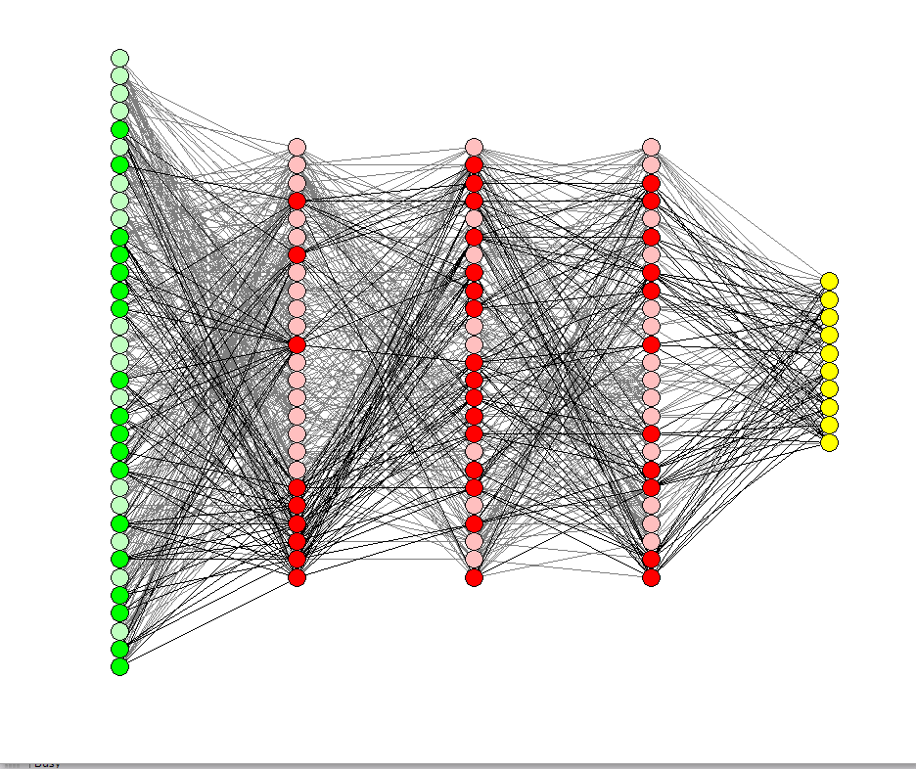
NN Training
Back propagation is the standard method for NN training today
It relies on advanced mathematics and can be challenging to understand
Is there a more intuitive NN training method?
Notes:
BP is an efficient gradient-descent method for teacher-based supervised learning in discrete, differentiable networks of arbitrary depth. It is used for fine-tuning the weights of a NN, based on the error rate obtained in the previous iteration, to ensure lower error rates, and make the model reliable by increasing its generalisation.
Edges are weighted according to importance of certain connections, and hence the weights of these nodes to best map input to output is an optimisation problem. Training the weights of the edges is therefore an optimisation problem and PSO can be used to solve it.
https://mag.uchicago.edu/sites/default/files/1508_Kelly_Neural-network.jpg

Slide 6
Biomimetics
Natural metaphors
More intuitive algorithms
Can we replace back propagation with a biomimetic alternative?
Notes:
The other example of biomimicry inspired by biological NN. Inspired by neurons in the brain, we artificial networks of nodes analagous to neurons and weighted edges analagous to synapses which connect the input and output.
NN applications range from image processing and speech recognition to medical diagnosis and various types of forecasting.
Edges are weighted according to importance of certain connections, and hence the weights of these nodes to best map input to output is an optimisation problem. Training the weights of the edges is therefore an optimisation problem and PSO can be used to solve it.
https://mag.uchicago.edu/sites/default/files/1508_Kelly_Neural-network.jpg

Slide 7
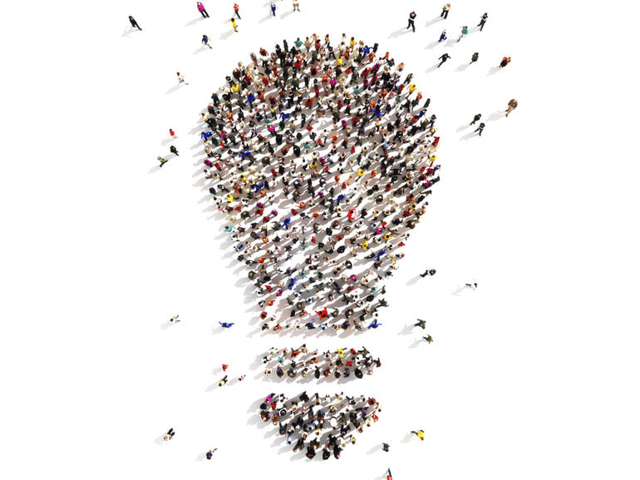
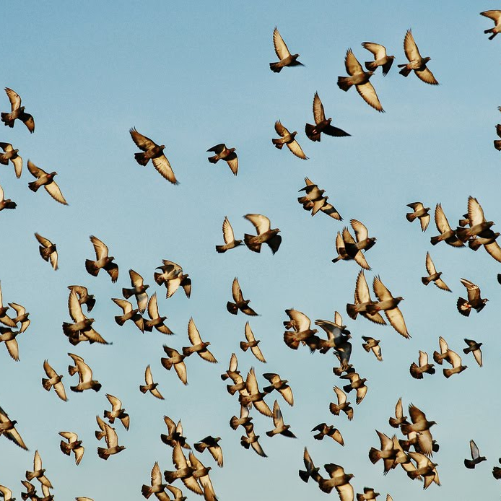
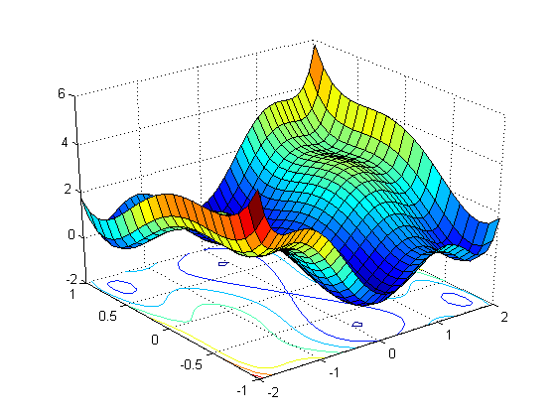
PSO for NN
PSO: type of Swarm Intelligence (biomimetic: bird swarms, fish schools)
Models applied to optimisation
Training NN is an optimisation task: PSO could be used for NN training
Notes:
The PSO algorithm iteratively searches for the global minimum of a function in an multi-dimensional space. It was derived from the behaviour of flocks of birds and schools of fish.
https://mag.uchicago.edu/sites/default/files/1508_Kelly_Neural-network.jpg

Slide 8
Points for investigation
“How does the original PSO algorithm compare to conventional methods for training NNs for image processing?”
Is it as accurate?
Is it as efficient?
Is it robust?
Will it work on complex datasets?
Notes:
The other example of biomimicry inspired by biological NN. Inspired by neurons in the brain, we artificial networks of nodes analagous to neurons and weighted edges analagous to synapses which connect the input and output.
NN applications range from image processing and speech recognition to medical diagnosis and various types of forecasting.
Edges are weighted according to importance of certain connections, and hence the weights of these nodes to best map input to output is an optimisation problem. Training the weights of the edges is therefore an optimisation problem and PSO can be used to solve it.
https://mag.uchicago.edu/sites/default/files/1508_Kelly_Neural-network.jpg

Slide 9
2. Results & Insights

Slide 10
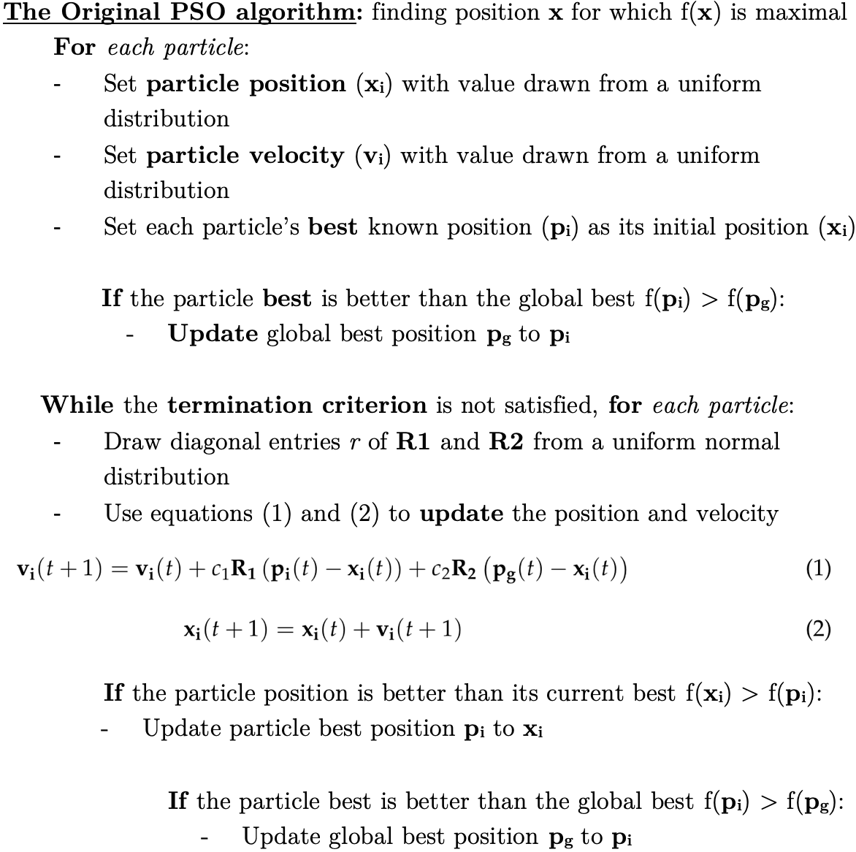
Simulating PSO
Initial position and velocity
Update particle best position and global optimum at every iteration
R₁, R₂, c₁, c₂ and v_{lim}
Notes:
The PSO algorithm iteratively searches for the global minimum of a function in an multi-dimensional space.
The algorithm is initiated by randomly placing many particles, with random velocities, in the search space.
At each step, every particle’s velocity is updated according to its previous velocity, its historically best position and the global optimum amongst all the particles.
Over time, the particles will search the space and converge to the optimal point evaluated, using a given fitness criterion.

Slide 11
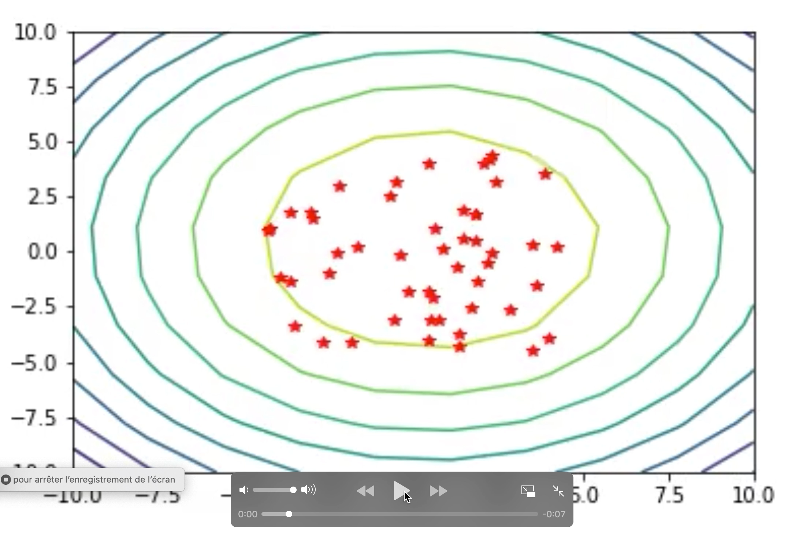
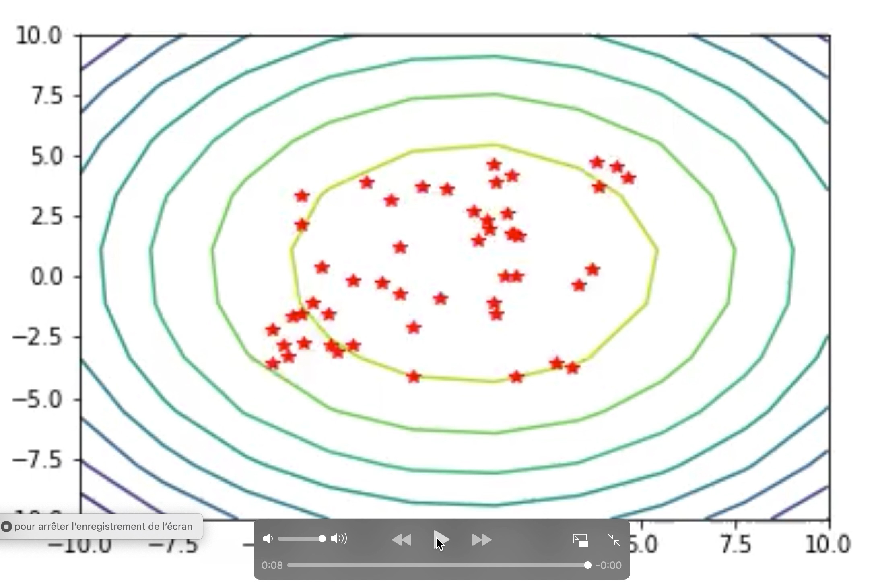
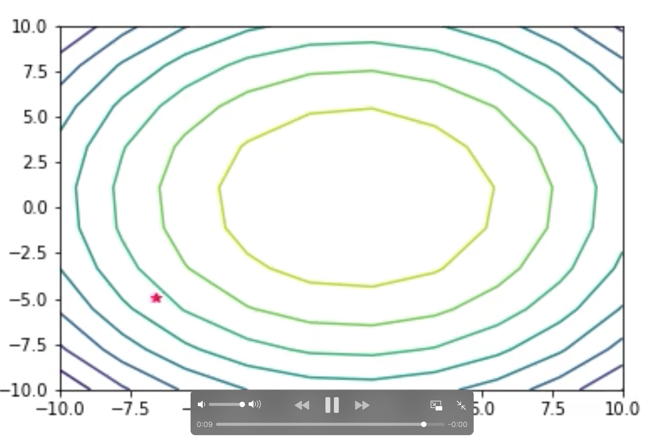
Experimenting with Parameters
Trade-off: time cost vs accuracy

Slide 12
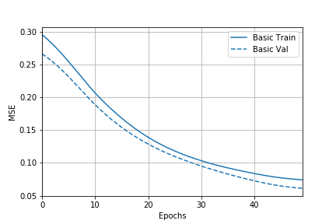
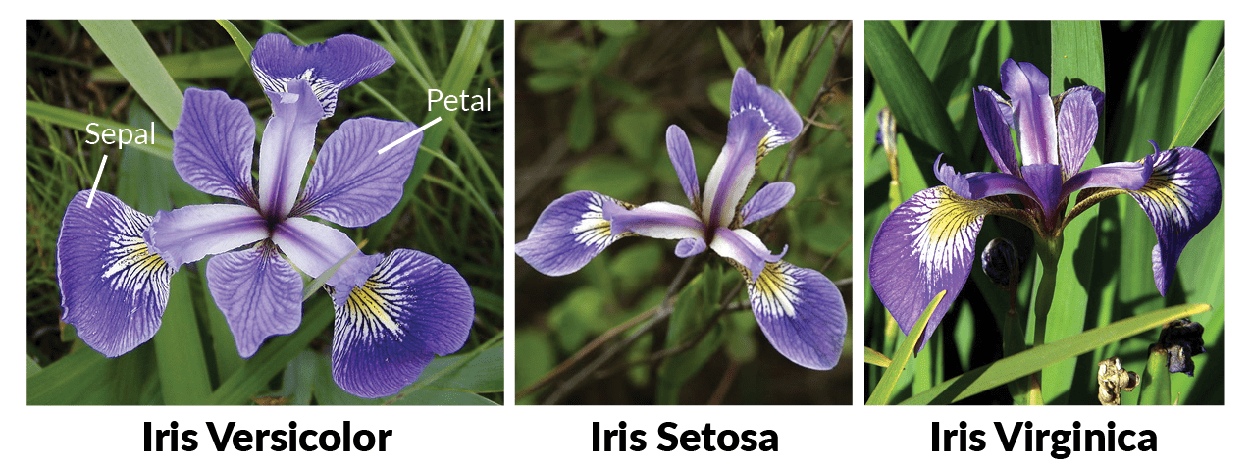
NN for IRIS
Simulated with Tensorflow
IRIS dataset
Backpropagation results
Accuracy = 93.333%
Notes:
We simulated our network using Python with the tensorflow library.
We first use Iris dataset which is a simple classification task that takes 4 numerical inputs and returns one of three flower type labels.
For a comparison measure we used backpropagation to train the weights for the network, we achieved an accuracy of **** ***SHOW GRAPHS***
https://upload.wikimedia.org/wikipedia/commons/thumb/9/9e/Iris_sanguinea.JPG/1200px-Iris_sanguinea.JPG

Slide 13
PSO-NN
The optimisation problem
Motivation for PSO trained NN
Notes:
PSO-NN is a method which uses a NN optimised by PSO to map from inputs to outputs.
We use supervised learning to train the network where we know corresponding input and output pairs. The optimisation problem we are solving is to find the weights of the edges which minimise the difference between the output mapped by our network and the known correct output.
Currently, NNs are trained using complex mathematical methods, such as back-propagation (BP),which beginners will often struggle to grasp. Switching to the more intuitive method of PSO for this.
One of the major advantages of bio-inspired algorithms is that they take inspiration from concepts that we are already familiar with. They present their own natural metaphors for thealgorithms being used, and this means that they are much easier to understand without a strong mathematical background.
NN training could open up the possibility for more people to take advantage of the opportunities machine learning has to offer. In this research project, we will evaluate whether the original PSOalgorithm can train NNs as well as conventional methods. If we find that PSO in its basic form givescomparable performance, it could be used to provide a simpler explanation for the optimisation of neural networks, making this complex field more accessible to beginners.
http://slideplayer.com/slide/9347431/28/images/1/Artificial+Neural+Network.jpg

Slide 14
Our PSO algorithm for our Neural Network
Methods
IRIS dataset: results
Notes:
http://2.bp.blogspot.com/-lhrDQ2Ysh38/UjMmT8r-LYI/AAAAAAAAkuw/_XtgH00EHCA/s1600/Iris+Flowers+24.jpg

Slide 15
3. Conclusion and future steps

Slide 16
Our beautiful graph

Slide 17
Parameters

Slide 18
Conclusion

Slide 19
Particle Swarm Optimisation for Neural Networks
4G4 Group Presenation
Group 8: Kimberly Barker, Louise Aumont and William Halfpenny
Notes:
LOUISE
https://www.howitworksdaily.com/wp-content/uploads/2015/07/wallpaper-of-a-flock-of-flying-birds-hd-bird-wallpapers.jpg

Slide 20
“How does the original PSO algorithm compare to conventional methods for training NNs for image processing?”
Notes:
LOUISE
https://www.stratio.com/wp-content/uploads/2019/02/Birds-blog.jpg
https://www.extremetech.com/wp-content/uploads/2015/10/AI.jpg

Slide 21
Simulating PSO
Swarm intelligence (SI), collective intelligence of simple homogeneous entities.
PSO is an example of SI applied to flocking birds and schools of fish
Application as an optimisation algorithm
Notes:
KIM
Swarm intelligence (SI) is the name given to the phenomenon where a group of simple homogeneous entities interact to perform a complex task together, without any central control system. These entities, known as "agents", individually follow simple rules, unaware of the global intelligent system created by the local, and partially random, coordination between them. SI is observed in nature in the collective behaviour of ant colonies, flocks of birds and many more animal groups. Artificial SI is an area of biomimetics, which takes inspiration from the principles of swarming behaviour, in applications ranging from simulation and artistic purposes, to swarm robotics and optimisation algorithms.
This research project will focus on the use of the particle swarm optimisation (PSO) algorithm. PSO is just one example of SI derived from the behaviour of flocks of birds and schools of fish. (I) Cohesion: birds steer towards the centroid of their neighbours,(ii) Separation: birds maintain relative position to neighbours,(iii) Alignment: birds match their velocity to match that of their neighbours.
PSO is an optimisation algorithm inspired by swarm behaviour which iteratively searches for the global minimum of a function in an multi-dimensional space. The algorithm is initiated by randomly placing many particles, with random velocities, in the search space. At each step, every particle's velocity is updated according to its previous velocity, its historically best position and the global optimum amongst all the particles. Over time, the particles will search the space and converge to the optimal point evaluated, using a given fitness criterion. Especially good for non-differentiable functions or dynamic systems.
https://i.pinimg.com/originals/8f/7f/58/8f7f5804f8bc073ce54f41953799854b.jpg

Slide 22
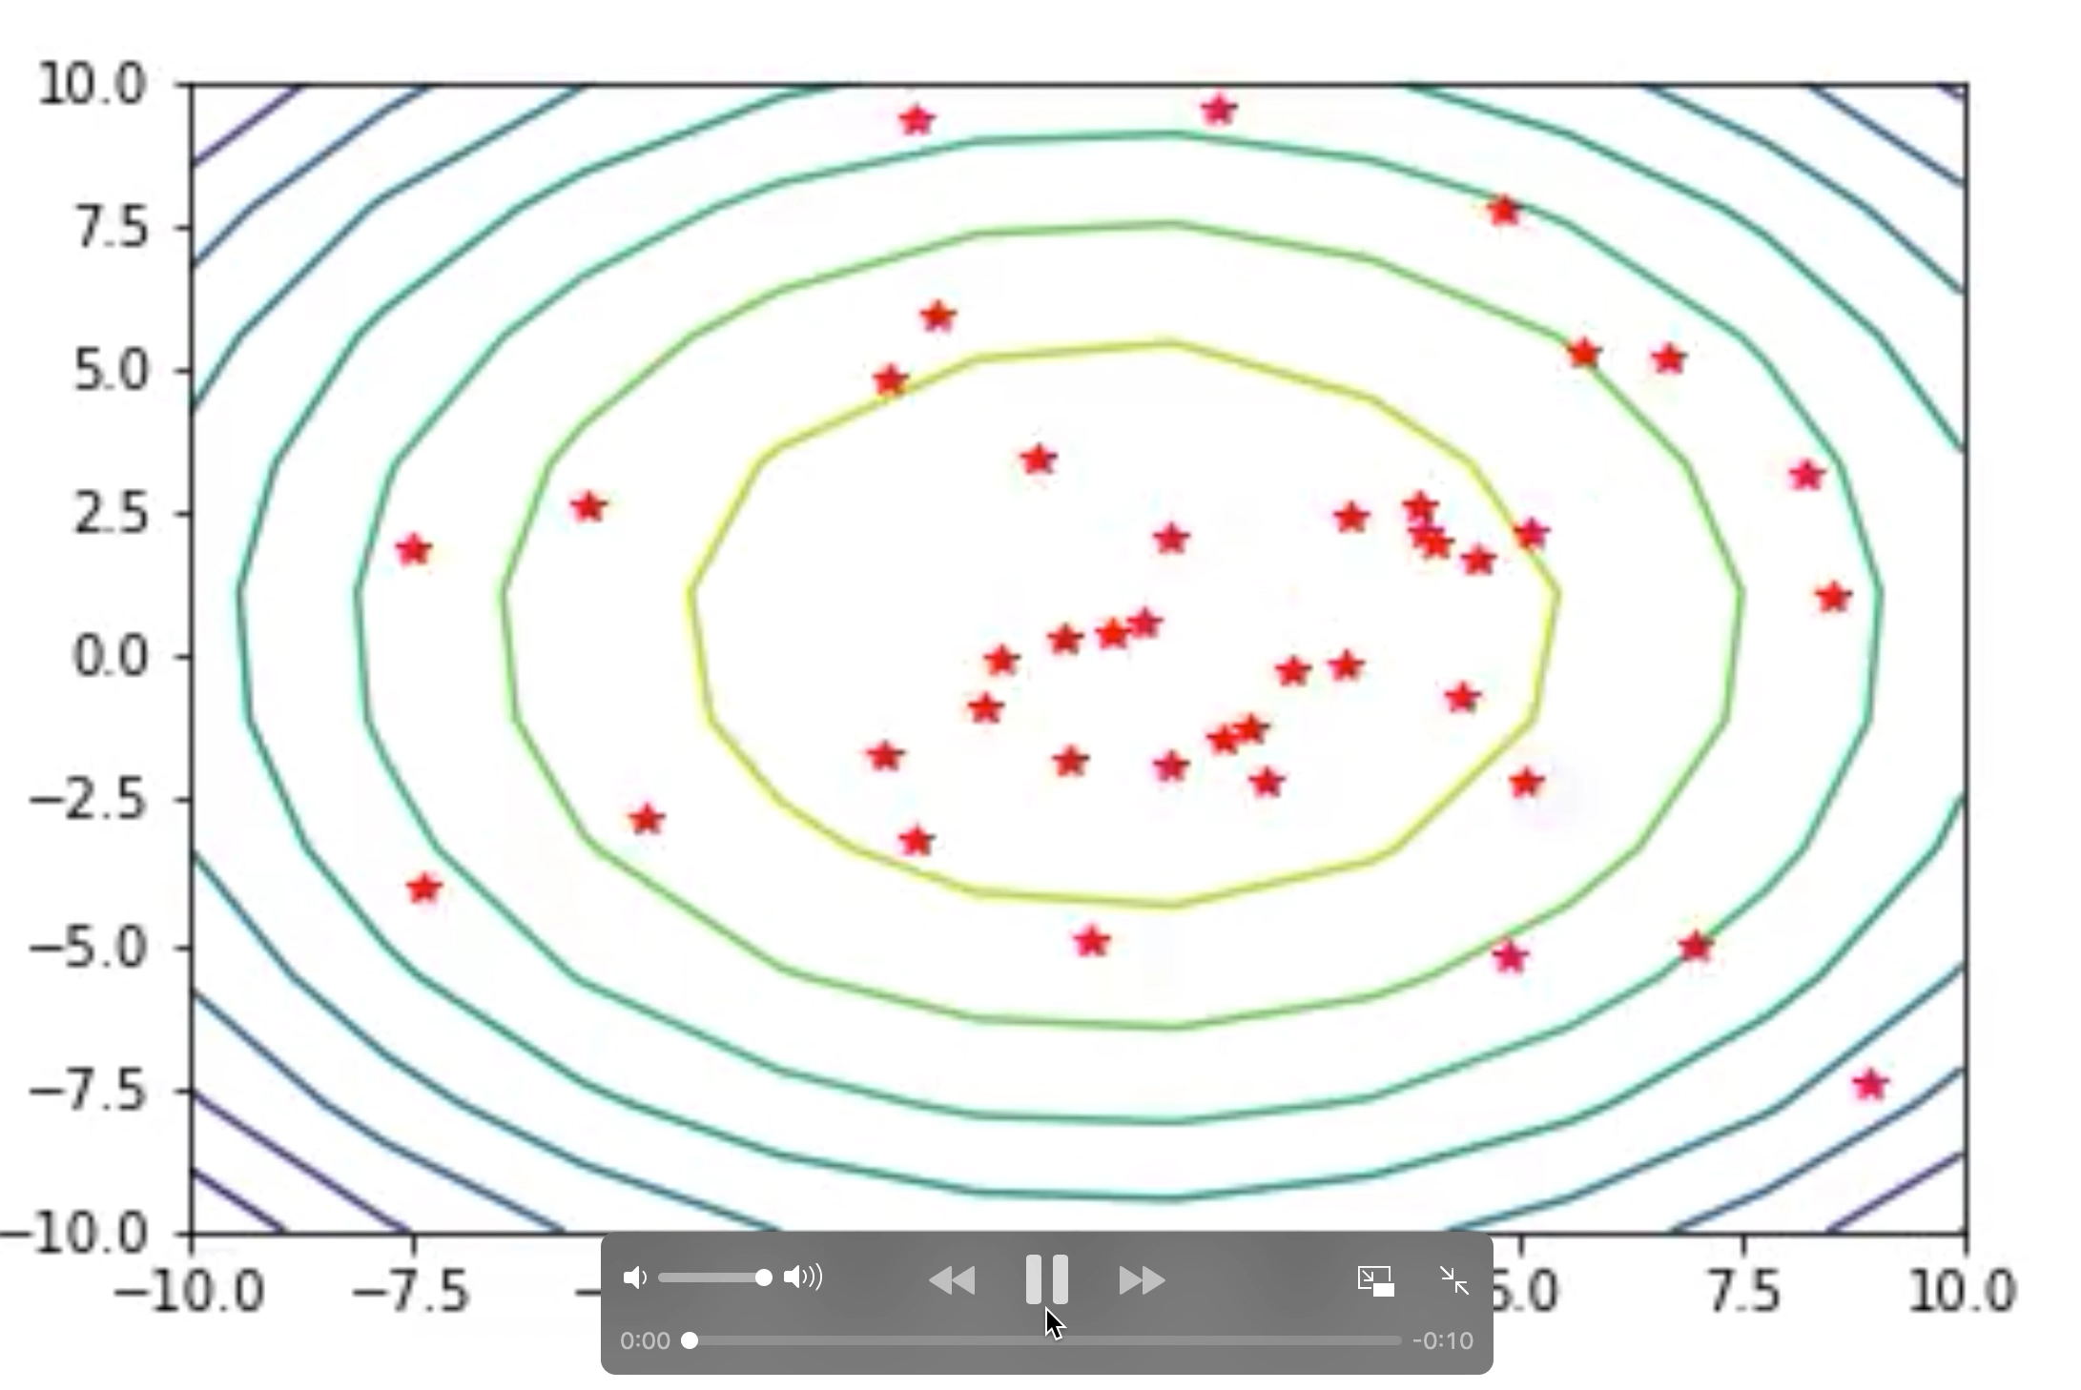
Unbound velocity (no v_{lim})
Particles can miss optimum

